Slide 1
BASIC BANKING SYSTEM WEBSITE
Internship at Sparks Foundation
#GRIPMAY21

Slide 2
AGENDA
Introduction
Objective
Description
Output
Links

Slide 3
INTRODUCTION
A bank is a financial institution and a financial intermediary that accepts deposits and channels those deposits into lending activities, either directly or through capital market.
This Bank is a basic bank where we can transfer money from our account to the client and see the transaction history.
Basic website for money transfer to gain the knowledge of the website creation.
Only front end development of website is involved

Slide 4
OBJECTIVE
AIM: To create a basic banking front end website with 10 client account sample data and transfer the money from our account to client.
SCOPE: Basic front end website for easy online share, and can develop with database for further.
Tools Used: HTML (100%)

Slide 5
DESCRIPTION
Creating a simple dynamic website.
First creating a dummy data in database for upto 10 customers.
Customers table will have basic fields such as name, email, current balance etc. Transfers table will record all transfers happened.
Flow: Home Page > View all Customers > Select and View one Customer > Transfer Money > Select customer to transfer to > View all Customers .
No Login Page. No User Creation. Only transfer of money between multiple users.

Slide 6
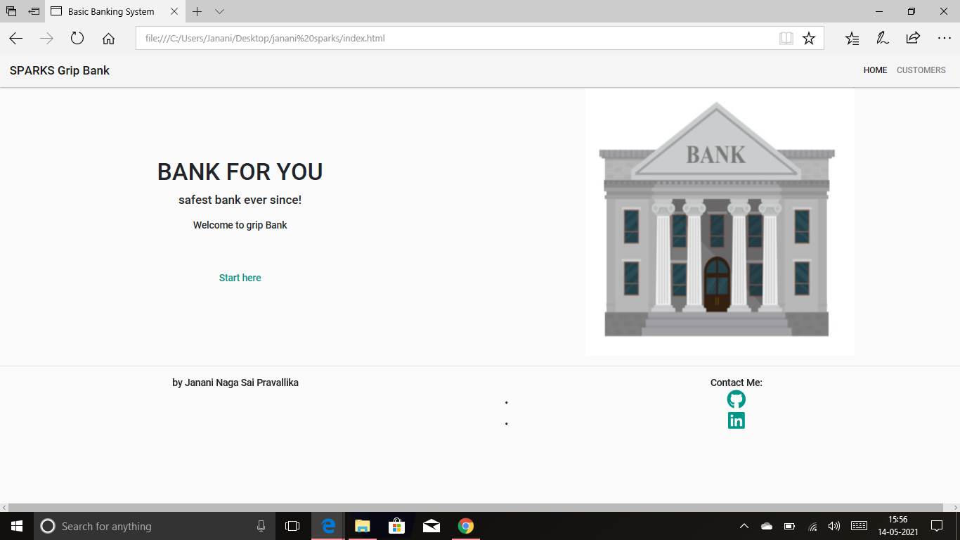
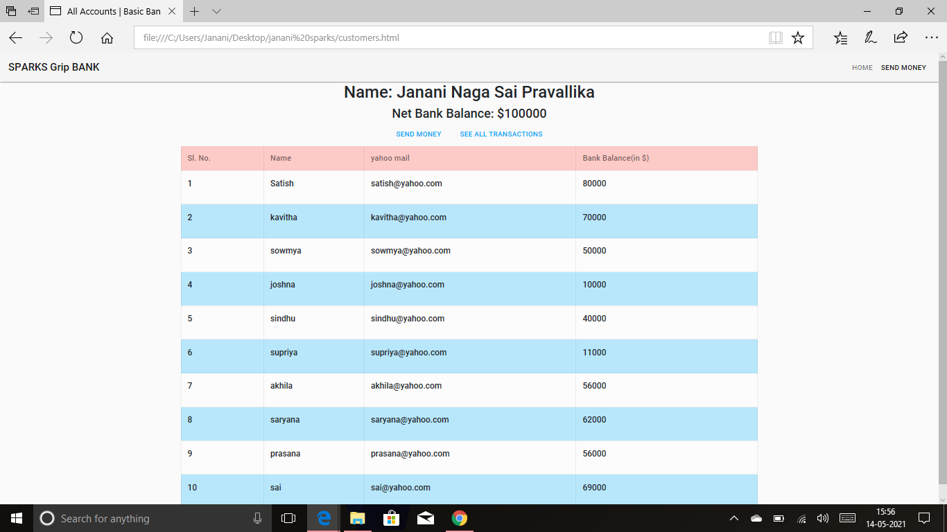
OUTPUT
Fig: Home page
Fig: Customer

Slide 7
I hear by thank you for giving me the opportunity to work @Sparksfoundation. Place where we get all our opportunities.
Sparks website: https://www.thesparksfoundationsingapore.org/
Github Link: https://bit.ly/3fl8qib
For any query: https://bit.ly/3eMvYgI

Slide 8
THANKYOU!
BY: G Janani Naga Sai Pravallika

